Slide 1

Airline Reservation System
M.VenkataLakshmi.
51897634

Slide 2
OBJECTIVE OF OUR PROJECT
The Aim of our project is to design and develop a software which would automate the major airline operations like providing the facilities for the reservation of online air tickets or any other operations through an effective for a normal passenger intending to travel through airways.

Slide 3
Registration Process:
Firstly we ask passenger to give his details .
After registering the passenger can logon to his/her own account and book his flight.
Once Passenger registered with us can book any number of tickets.

Slide 4
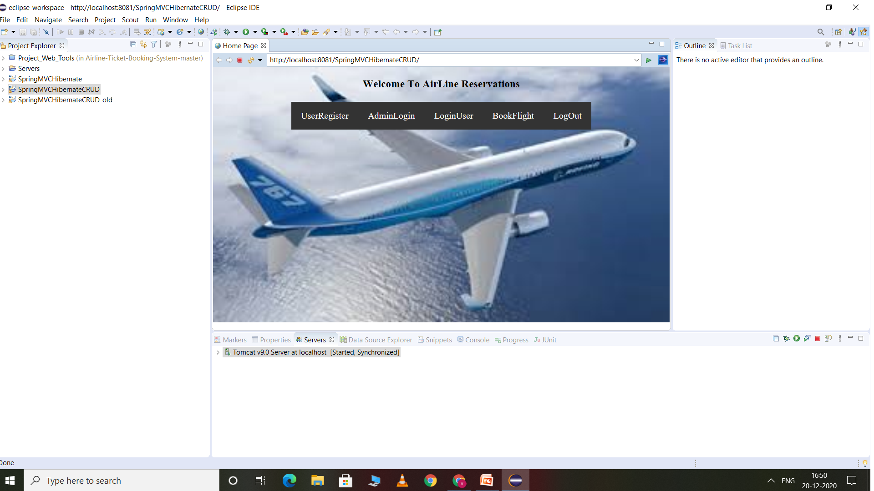

Slide 5
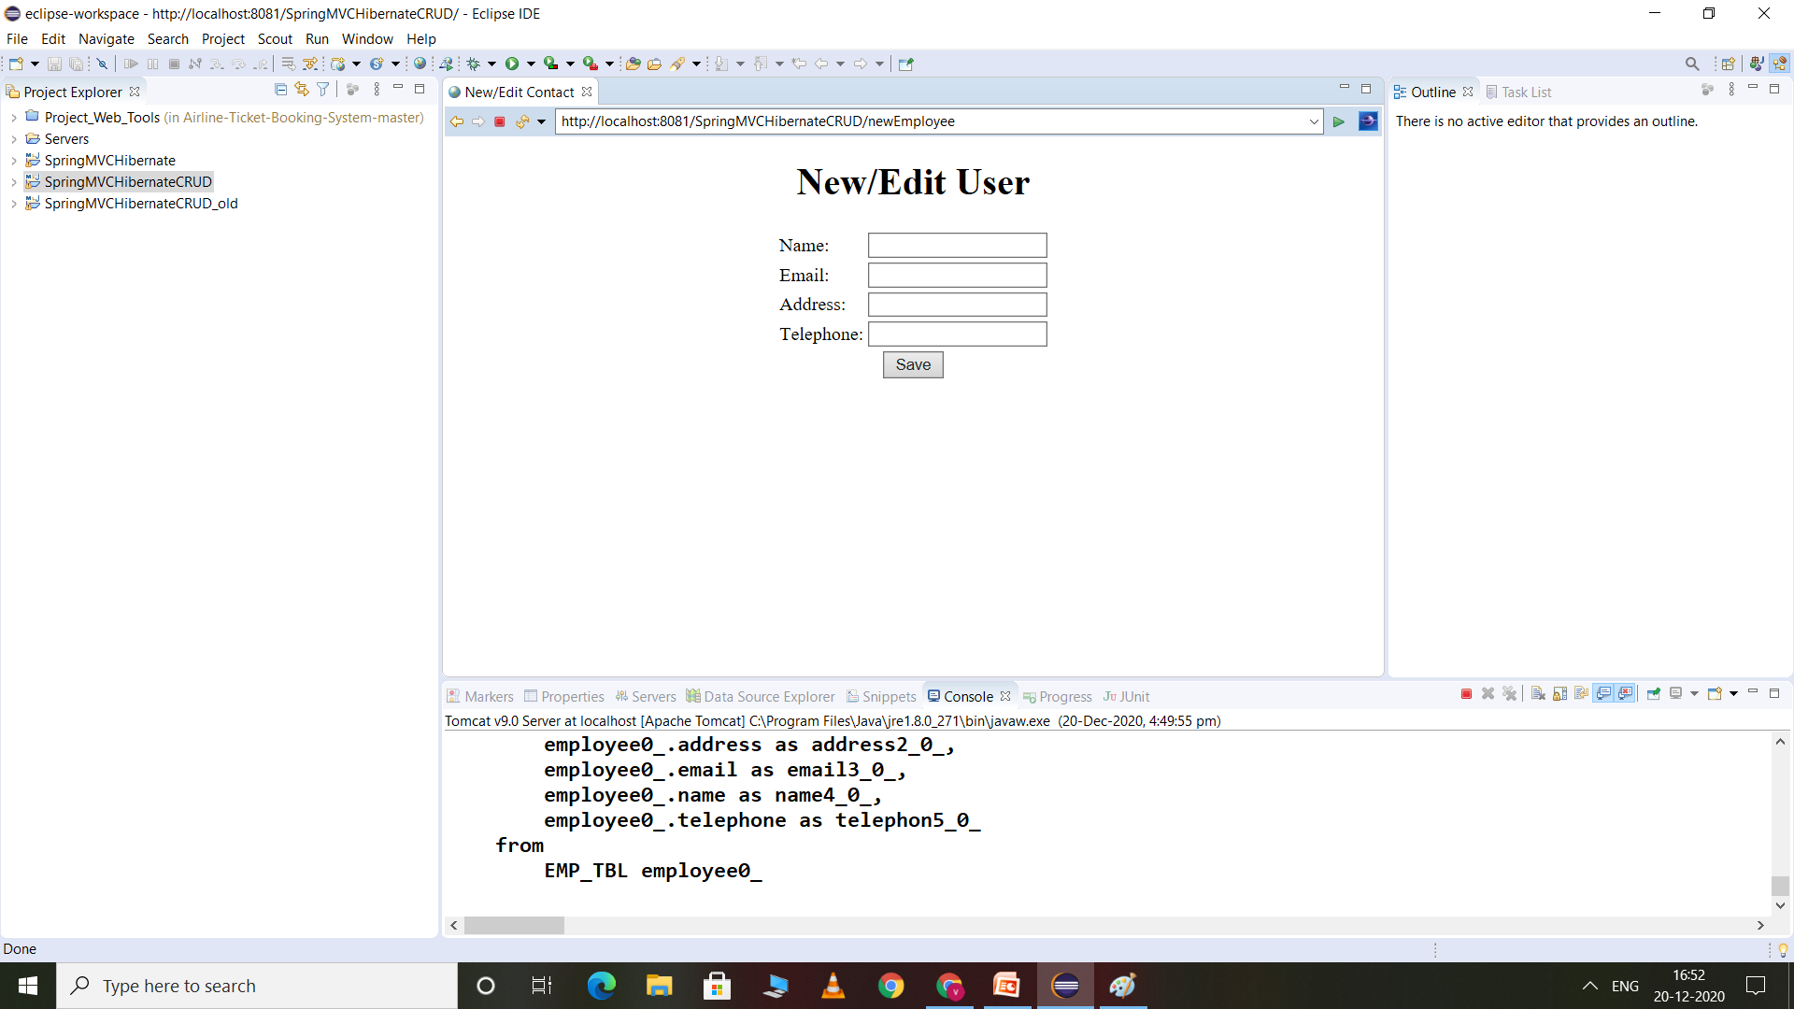

Slide 6
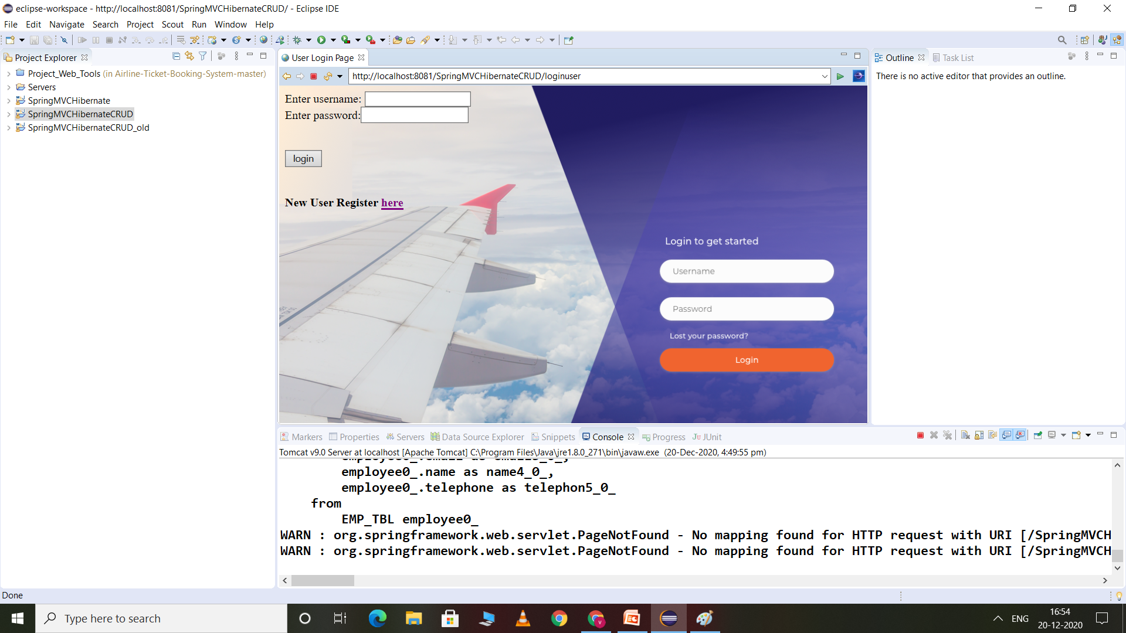

Slide 7
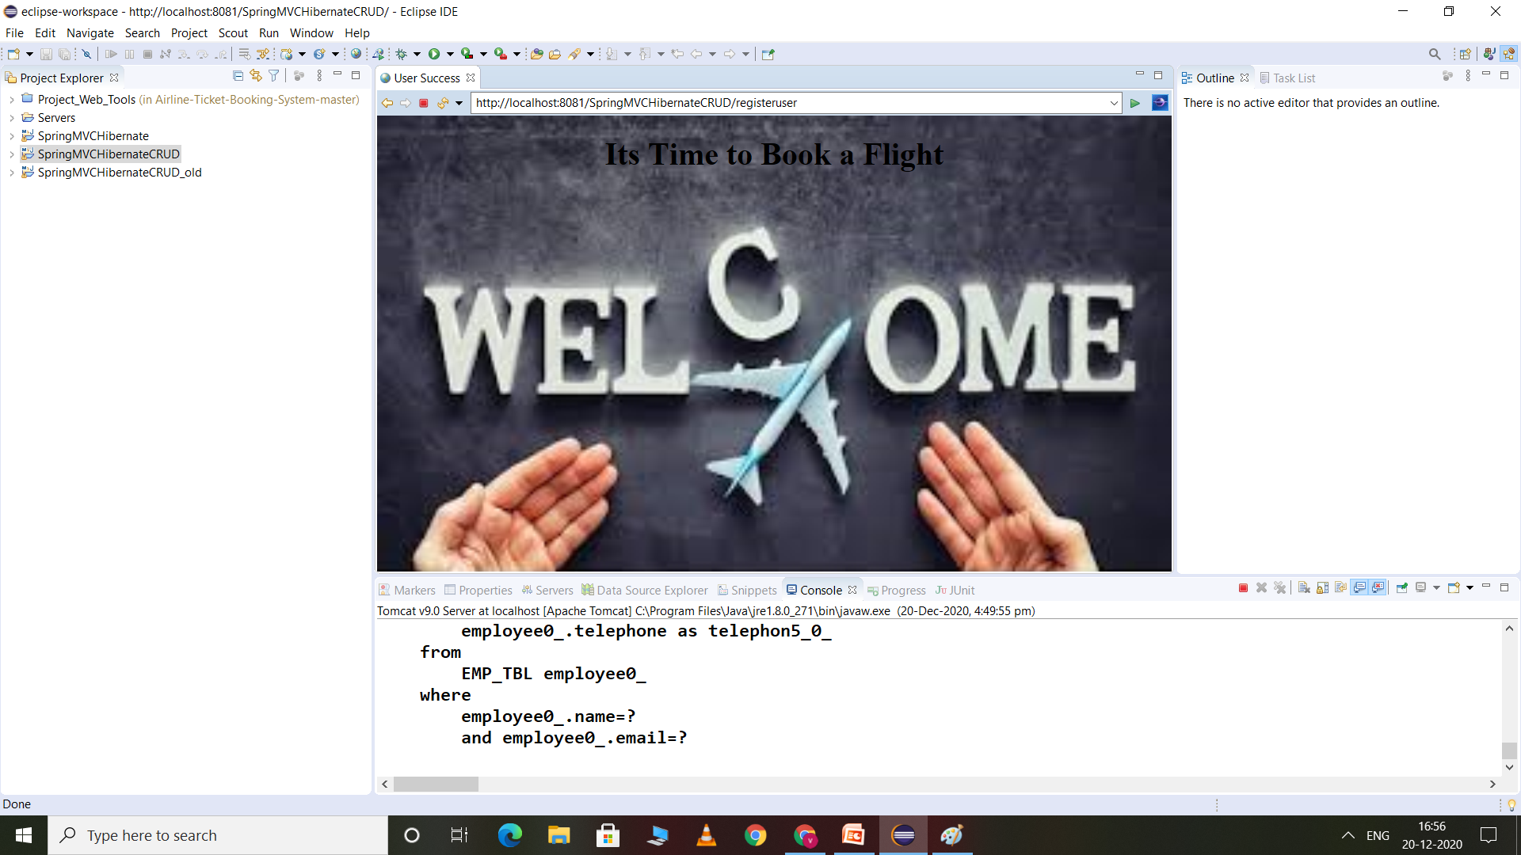

Slide 8
Administrator Module:
It is provided for the sake of administrators to manage the site and update the content at regular intervals, The major operations included in this module are:
Create and maintain airline schedule and timings of the Flight.
View the passenger list.
View the available flights.
Cancel the tickets.
Updating the flight schedule and timings .

Slide 9
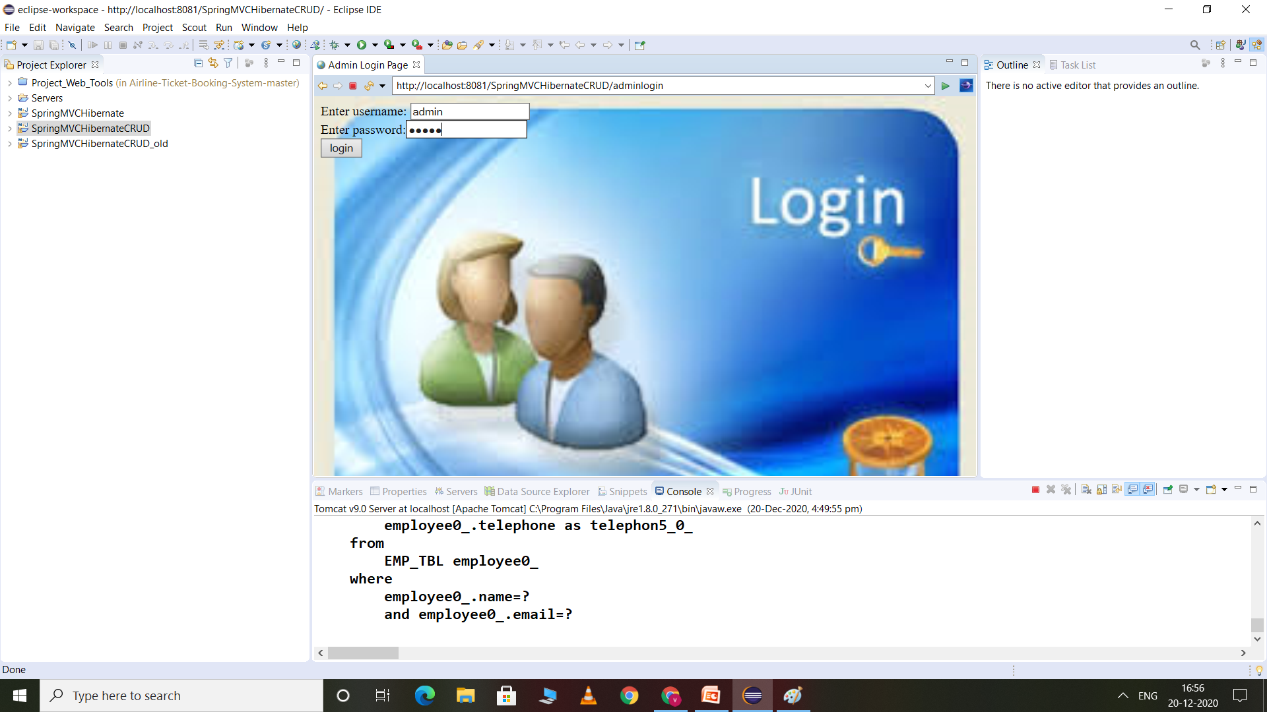

Slide 10
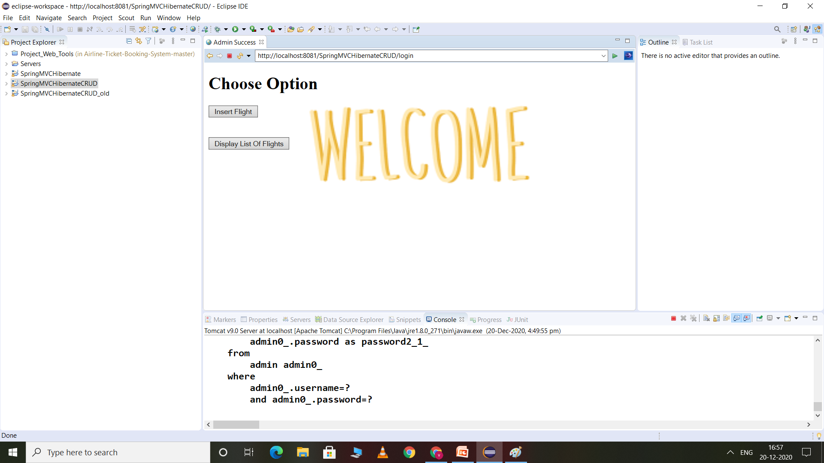

Slide 11
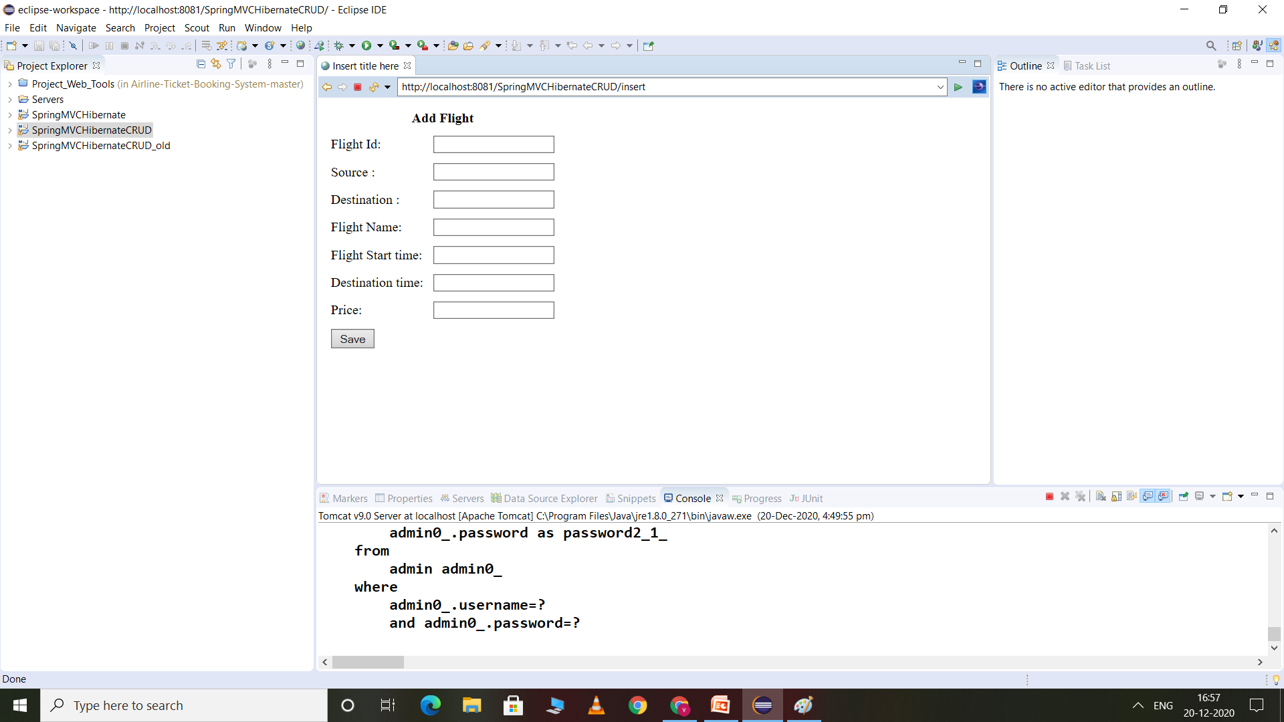

Slide 12
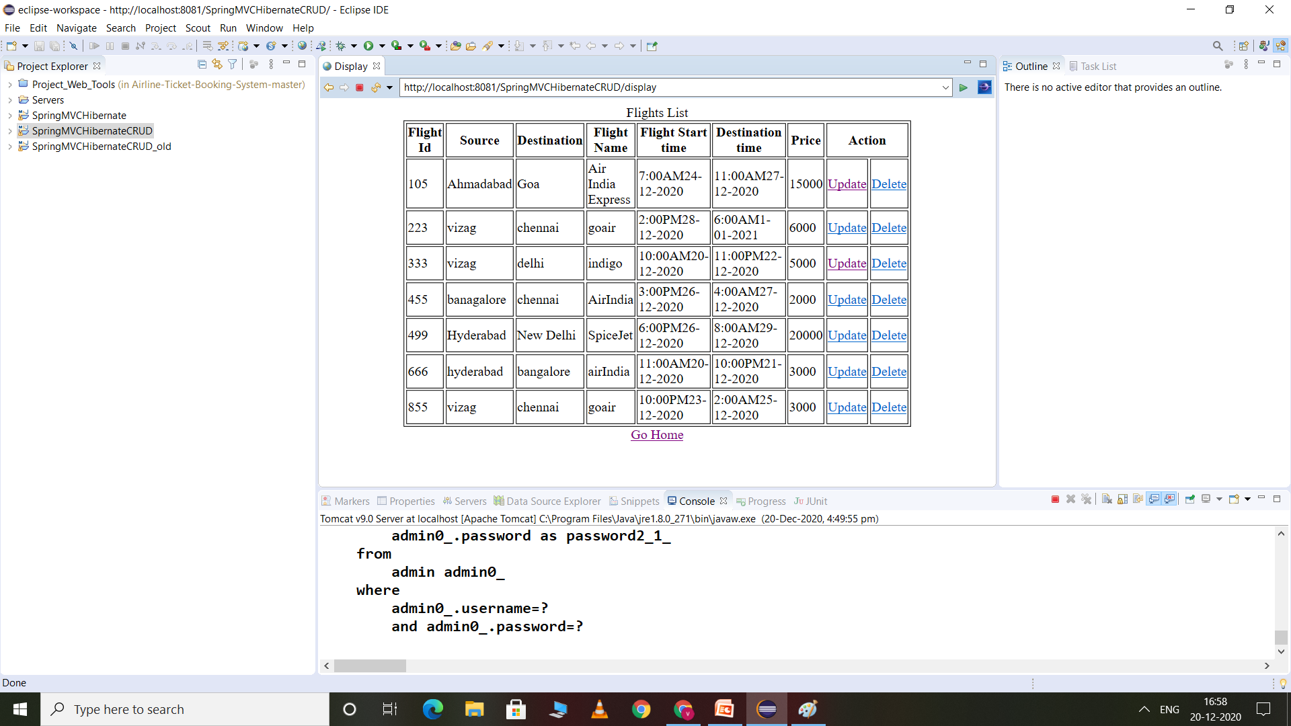

Slide 13
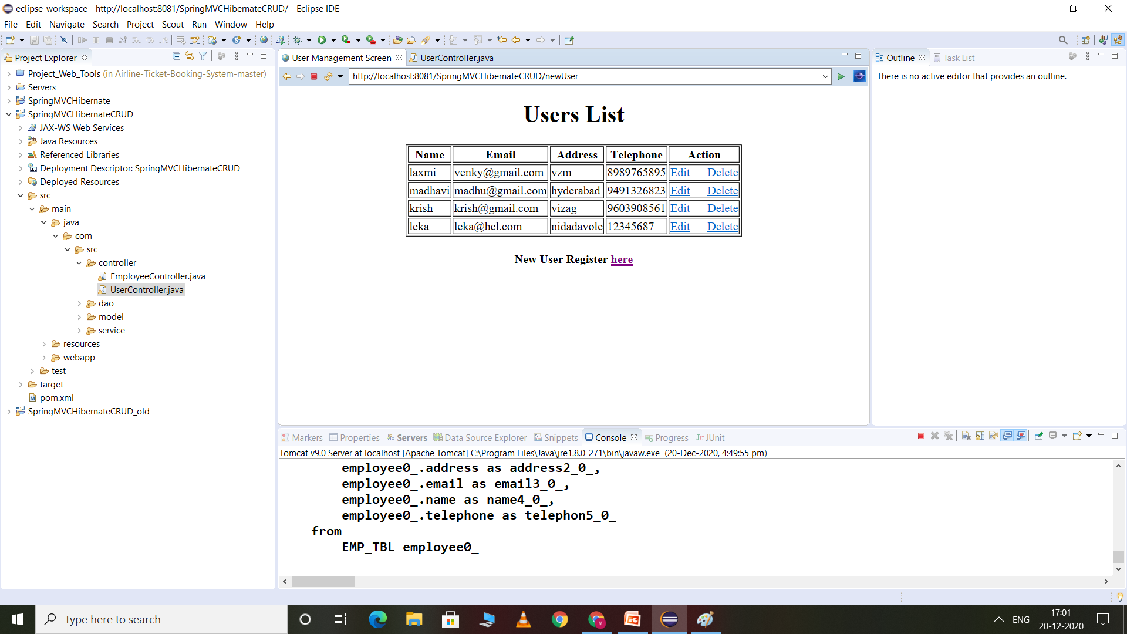

Slide 14
Passenger’s Module:
It is meant for passengers, where a user logging into his/her owns account will view this panel.
The major operations included in this module were View all airline schedules, timings, fare details and seats availability.
Book for the tickets.
View and cancelling of the ticket.

Slide 16
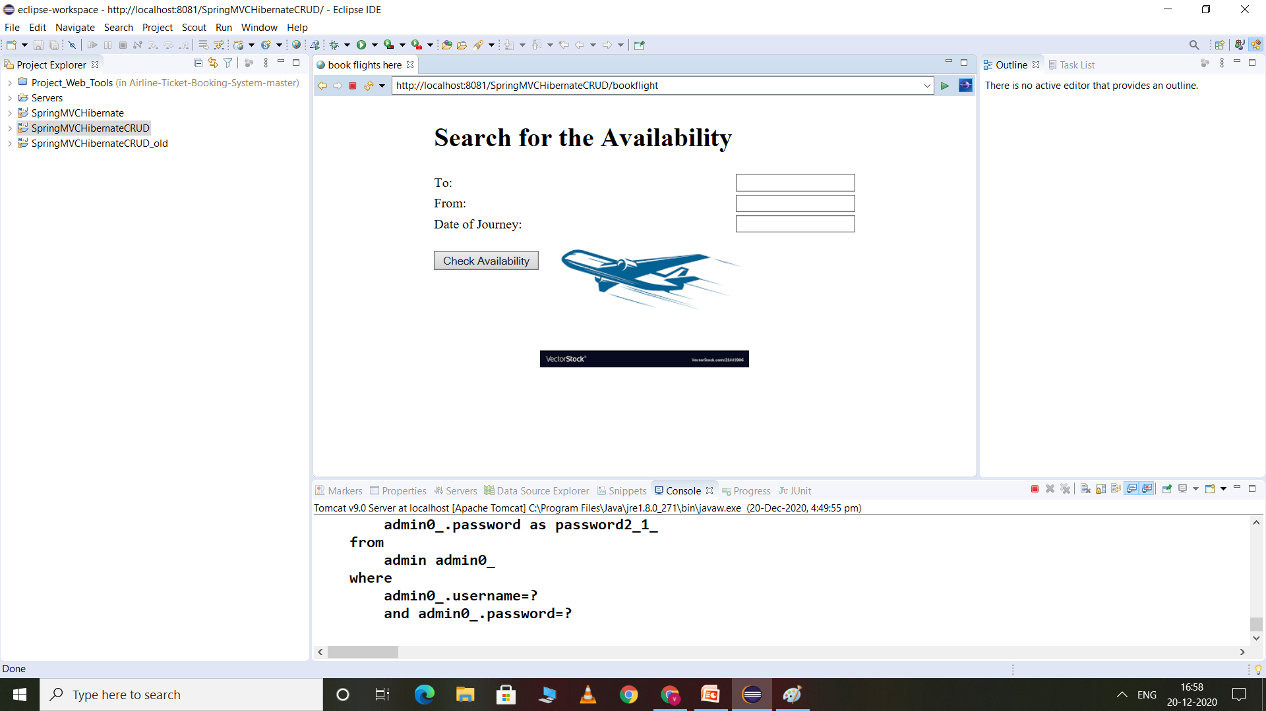

Slide 17
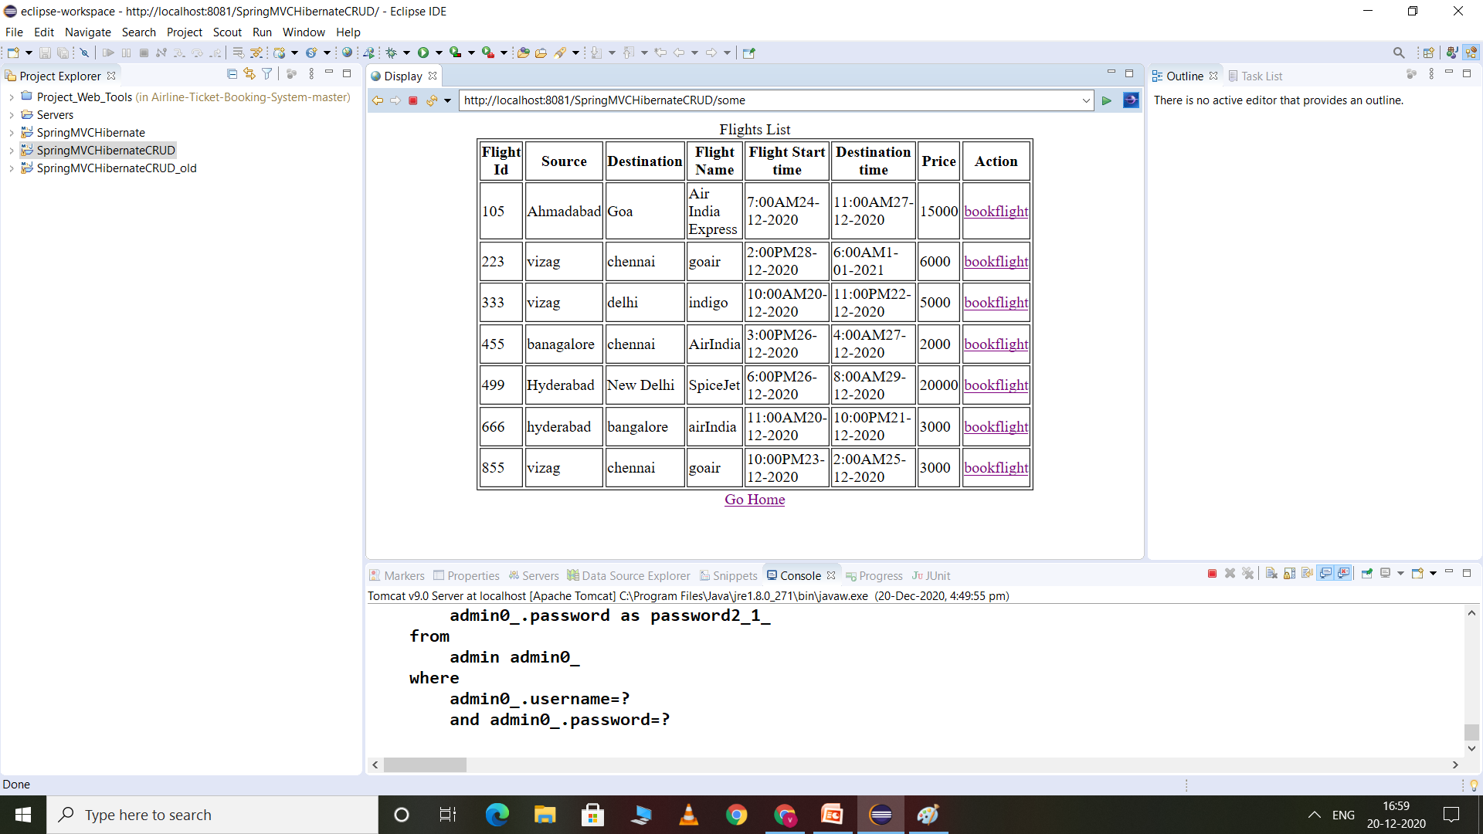

Slide 18
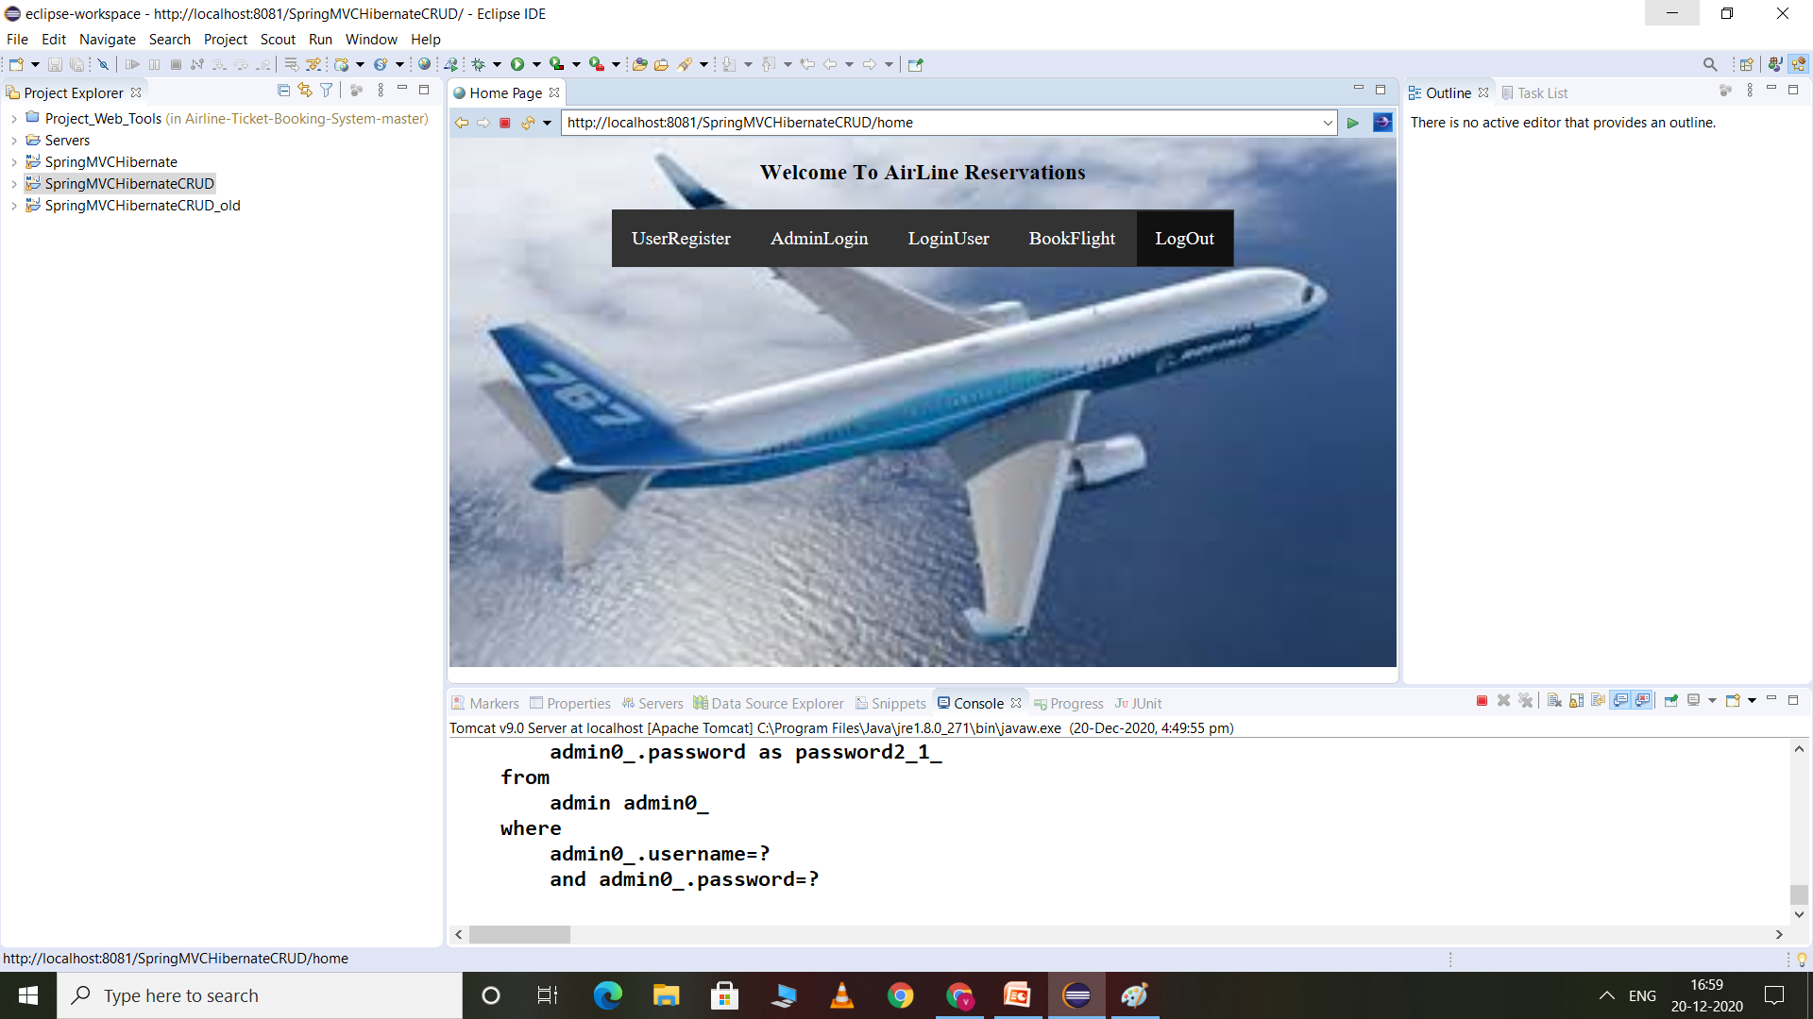

Slide 19
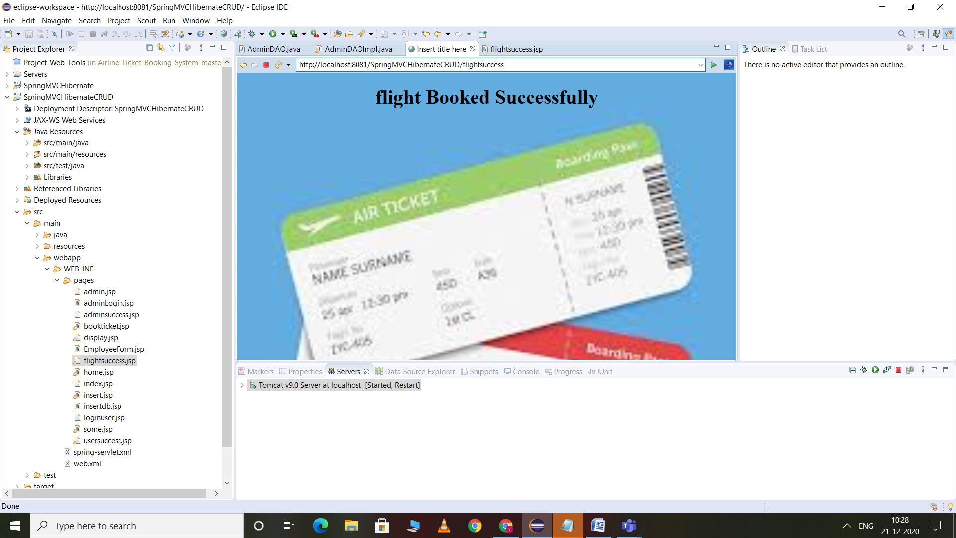

Slide 20
Homepage of Airline Reservation System
Home
BookTicket
Login
Signup
ContactUs
Create new User
1.Book flight tickets.
2.View booked flight tickets.
3.Cancle booked flight ticket.
ExistingUser

Slide 21
Technologies Used:
1.JAVA CORE
2.HTML.
3.JAVASCIPT.
4.JSP.
5.HIBERNATE.
6.MYSQL
7.MVC.
8.CSS.
9.JSTL.

Slide 22
Conclusion:
online reservation system, which enable customer to check the availability tickets & book their tickets .
It makes the customer easy to get ticket online instead of queue up to buy the tickets.

